Slide 1
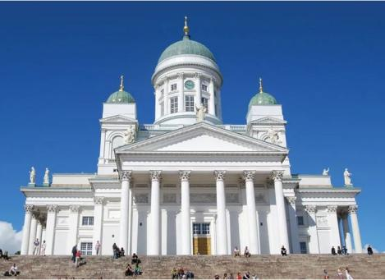
Cultivating Diversity and Inclusion
Helsinki
March 2024

Slide 2
Day 1
1. Warm up
2. Presentation of schools
3. Let’s explore Finland: Finnish Education, Finnish culture
4. Diverse Classroom: challenges and barriers

Slide 3
Education for all
The development of the whole education system takes time. During the first years of the 20th century, only a third of rural children went to school.
The 1921 act on compulsory education started the path towards a modern education system based on the philosophy of education for all.
Today education from pre-primary to higher education is free of charge for Finns and citizens from EU/ETA countries. Early childhood education and care is subsidized.

Slide 4
The Finnish education system today
Secondary education
Tertiary education
16-19-year-olds
Matriculation examination in general upper secondary schools
Appr. 3+2 years
Bachelor’s and Master’s degrees at Universities
Doctoral degrees and licentiate degrees in Universities
Basic education
0-5-year-olds
Early childhood education and care
6-year-olds
Compulsory pre-primary education
7–16-year-olds
Basic education in comprehensive schools
16-19-year-olds
Vocational qualifications in vocational institutions
Appr. 3+2 years
Bachelor’s and Master’s degrees at Universities of Applied Sciences
Notes:
The Finnish education system today consists of early childhood education and care, one-year pre-primary education, nine-year basic education, upper secondary (general or vocational) and higher education.
Additionally, lifelong/continuous learning is emphasized and adult education is available at all levels of education and in non-formal education. It is no coincidence that in Finland enrolment in adult education ranks among the highest in the world together with other Nordic countries.

Slide 5
Minimum number of teaching hours per week
The legislation defines the minimum number of hours a pupil is entitled to receive instruction per week. The minimum number of hours is:
1st and 2nd grade 20 hours a week
3rd grade 22 hours a week
4rd grade 24 hours a week
5st and 6nd grade 25 hours a week
7st and 8nd grade 29 hours a week
In the 9th grade, 30 hours a week.

Slide 6
Teaching hours for teachers
Primary 24h/week
Secondary 16-24 h/week
Vocational 1600hrs/year
More lessons= more pay

Slide 7
Subjects in General Upper Secondary Schools (150 credits)
Mother tongue and Literature (Finnish or Swedish)
Second National Language (Finnish or Swedish)
Foreign Languages (English, German, French, Spanish, Chinese, Italian, Latin)
Maths and Natural Sciences (Biology, Geography, Physics, Chemistry))
Humanities and Social Studies (Philosophy, History and Social Studies, Psychology)
Religion and Worldview studies
Physical education, other arts and skills, and health education (Visual arts, physical education, music, health education)
Guidance counselling (not graded)
Diplomas (home economics, visual arts, home crafts, media, music, dance, theatre)

Slide 9
Day 2
1. Toothpicks game
2. Human rights bingo
3. Perspective talk
4. The danger of a single story

Slide 10
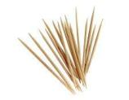
Toothpicks
Aim: Recognize the importance of learning the nonverbal rules of another culture
Observe how nonverbal messages can be cultural and/or gender specific.
Experience the feeling of behaving inappropriately when the rules are unspoken
What did it feel like to give toothpicks? To receive them?
How easy or hard was it to discover what someone else’s nonverbal rules were?
What does this activity suggest about how easy or hard it is to interact when you don’t know the rules?
How do nonverbal behaviours affect communication? Personal interactions? Perceptions of others?

Slide 11
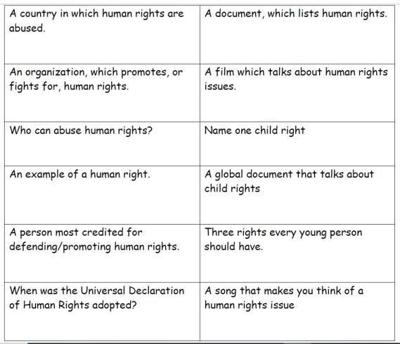
Humans Right Bingo

Slide 12
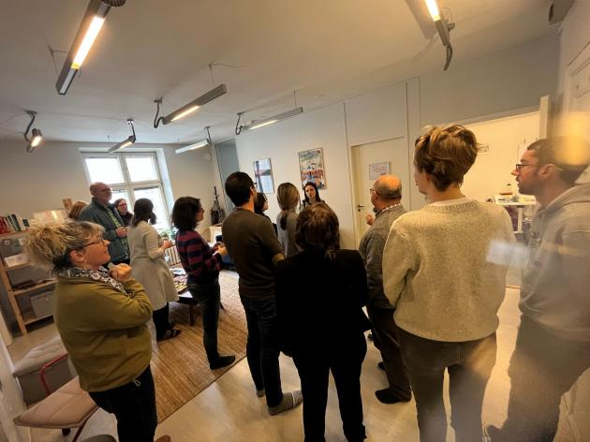
Low – High Priority

Slide 13
Low Priority-High Priority
Form a line between the ‘LOW PRIORITY’ and the ‘HIGH PRIORITY’ signs.
Where you stand in the line depends on where you think your right fits in order of priority.
Discuss with other people in the room to decide whose rights are more or less important.
Do you all agree on the order of priority that you have come up with?
Would you change your position if you lived in a different country/in a different time period?

Slide 14
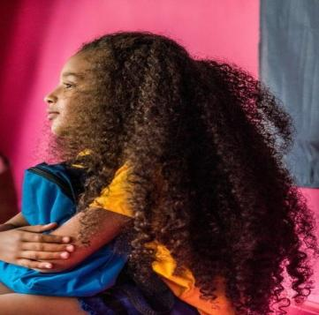
Every picture tells a story

Slide 15
Everyone has a story. Things are not always as it looks.

Slide 16
The Danger of a Single Story (video)

Slide 17
Day 3
1. Culture
2. Why Intercultural Competence?
3. Public – Private Assessment
4. Pesronal and Social Identity wheels

Slide 18
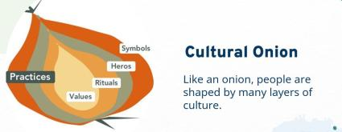
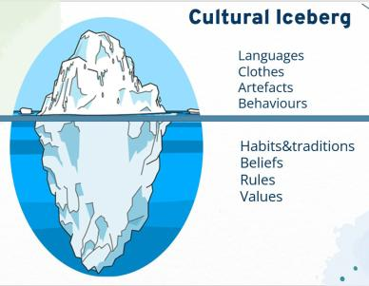
Culture

Slide 19
Poem by Bernard Werber
Between what I think
what I want to say
what I think I am saying
what I say
what you want to hear
what you hear
what you think you understand
what you want to understand
and what you understand
there are at least 9 chances
that we will not understand each other

Slide 20
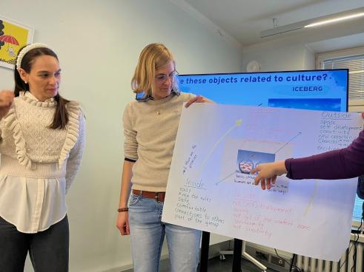
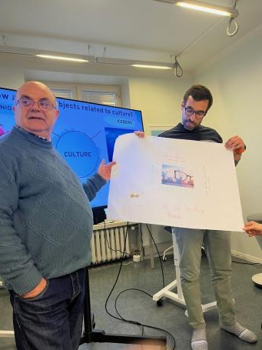
What is culture?

Slide 21
Why intercultural competence?
At the heart of intercultural competence
is the preparation of individuals
to interact effectively and appropriately
with those from other
cultural backgrounds.

Slide 22
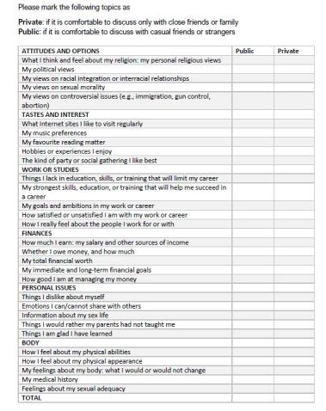
Private – Public self assessment

Slide 23
Dimensions of countries
Check the values for the 6 dimensions of your country in the following link
https://www.hofstede-insights.com/fi/product/compare-countries/

Slide 24
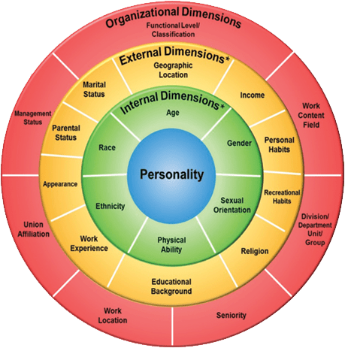
Personal and Social Identity Wheels
To encourage students to consider their identities critically.
To sensitize students to their shared identities with their classmates as well as the diversity of identities in the classroom, building community and encouraging empathy.

Slide 25
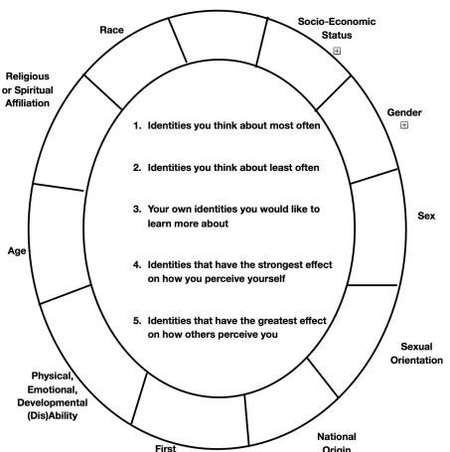
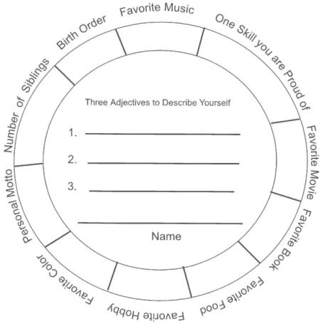

Slide 26
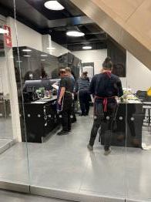
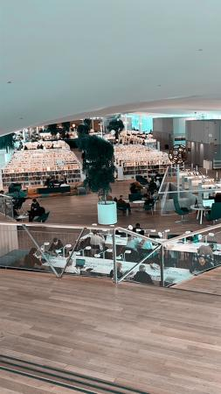
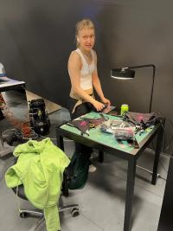
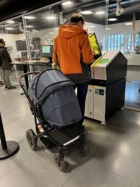
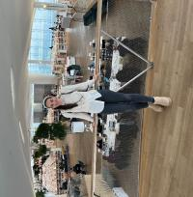
Helsinki Library

Slide 27
Day 4
1. Story Circles
2. The I am … poem
3. The GooseChase

Slide 28
Story Circles
Get acquainted round
Diversity round
Please tell us about a photo of an object that tells us something about you and your background
What is your earliest memory of difference (when you first learned or realized that you were different from someone else)?

Slide 29
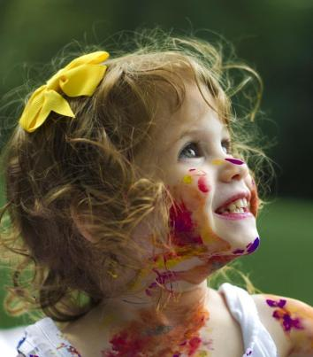
The I am … poem
I am from…
I am from the smell of homemade tortillas,
the sound of bachata playing in the background…

Slide 30
The GooseChase
PLACE YOUR SCREENSHOT HERE
An App for Inclusion

Slide 31
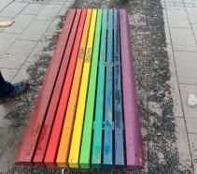
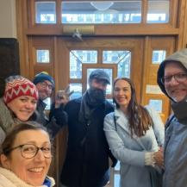
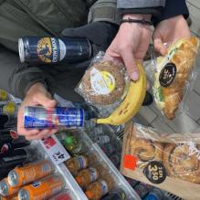
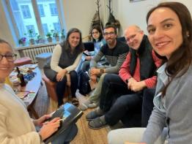
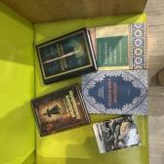
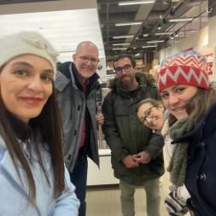
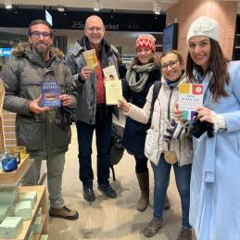
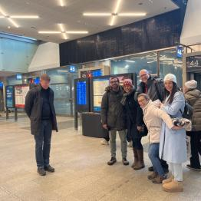
The GooseChase

Slide 32
Day 5
1. Challenges in our multicultural schools
2. Find problem
Create products or services to address the problem

Slide 33
We cannot return to the world as it was before.

Slide 34
Challenges in your multicultural school
Choose an idea that you want to offer a solution.
1st pitch: What is your problem? For whom? What are their needs?
Create products or services that meet your targets' needs
Visualize your product/service. How does it look like?
With Lego bricks, pictures, play doh, slides, mindmaps, etc.
2nd pitch: What is your product or service to the problem? How does it work? What is the cost?
Based on the feedback, make improvements to your product or service.
Final pitch: What is the problem? Who are you targeting? What is the product/service? How does it work?

Slide 35
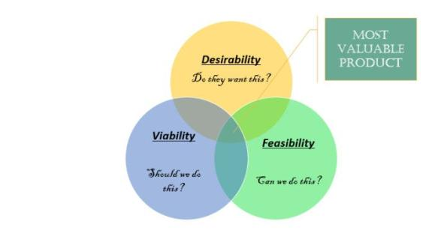
PROCESS OF FINDING POSSIBLE SOLUTIONS
Who will invest in this new product/service?
Will your targets want to use your product/ service?
Is this product/service technically and financially feasible and viable?

Slide 36
Challenges in my multicultural school
Problem: Different values, ethics, way of thinking, norms, beliefs
For whom: students, teachers, parents, community
Needs: understand, communicate, respect, integration, interaction, need for belonging, sense of community, enrollment, develop
Product/services: workshop – 1 week during school hours
Literature
History
Sports day
Food, dance, music, dressing
Communication, language, Greeting, Interaction, attitudes

Slide 37
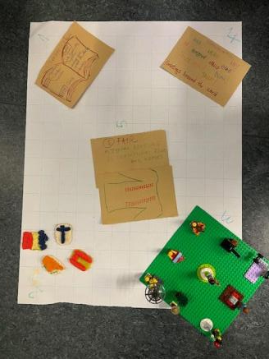
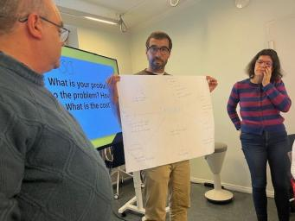
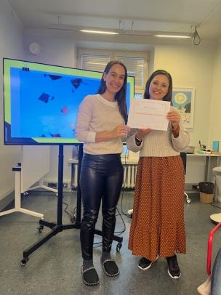

Slide 38
